Slide 1
Day 2 Morning: Empirical Research in HCI
PollEv.com/szhao168

Slide 2
Agenda
Why empirical research?
What is empirical research?
How to do empirical research?

Slide 3
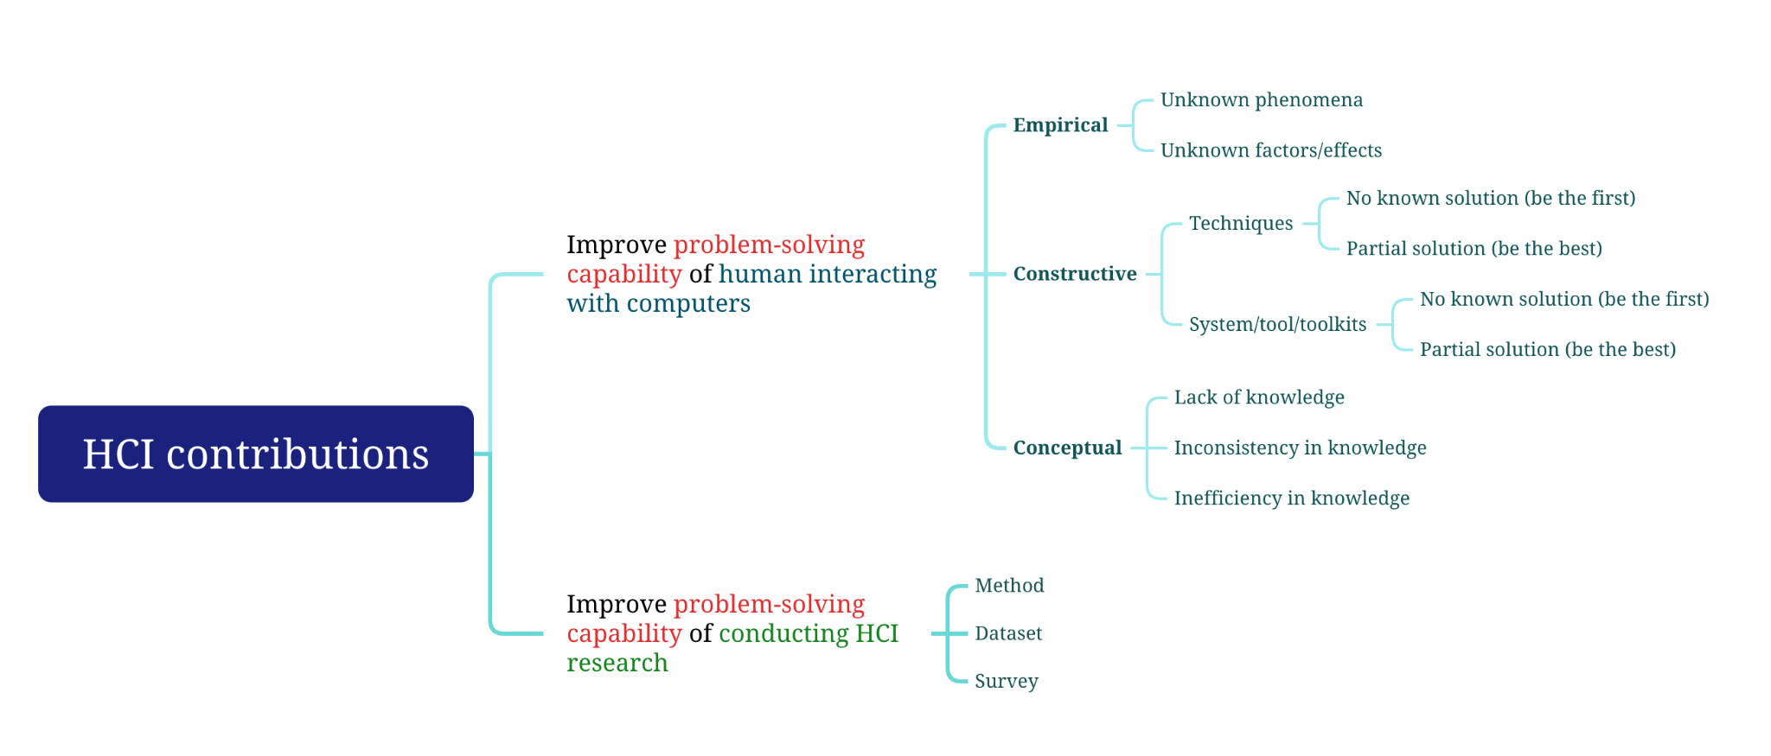
Recap - Summary of HCI contributions

Slide 4
Recap - Empirical research contributions?
[O&H’16] Empirical research is aimed at creating or elaborating descriptions of real-world phenomena related to human use of computing
Unknown phenomena
Unknown factors
Unknown effects
[Wob’12] Empirical findings are based on observation and data-gathering
These findings come from variety of sources
Experiments, user tests, field observations, interviews, surveys, focus groups, diaries, ethnographies, sensors, log files, etc.
Purpose
Form

Slide 5

Q1
PollEv.com/cs6206week4

Slide 6
Questions to Consider
Why empirical research?

Slide 7
Questions to Consider
Why empirical research?
Core of a user-centered discipline

Slide 8
Questions to Consider
Why empirical research?
Core of a user-centered discipline
Users are the end goal

Slide 9
Questions to Consider
Why empirical research?
Core of a user-centered discipline
Users are the end goal
How does it relate to other HCI research?

Slide 10

Empirical Understand a phenomenon
Conceptual
Form a theory
Constructive
Develop a solution

Slide 11
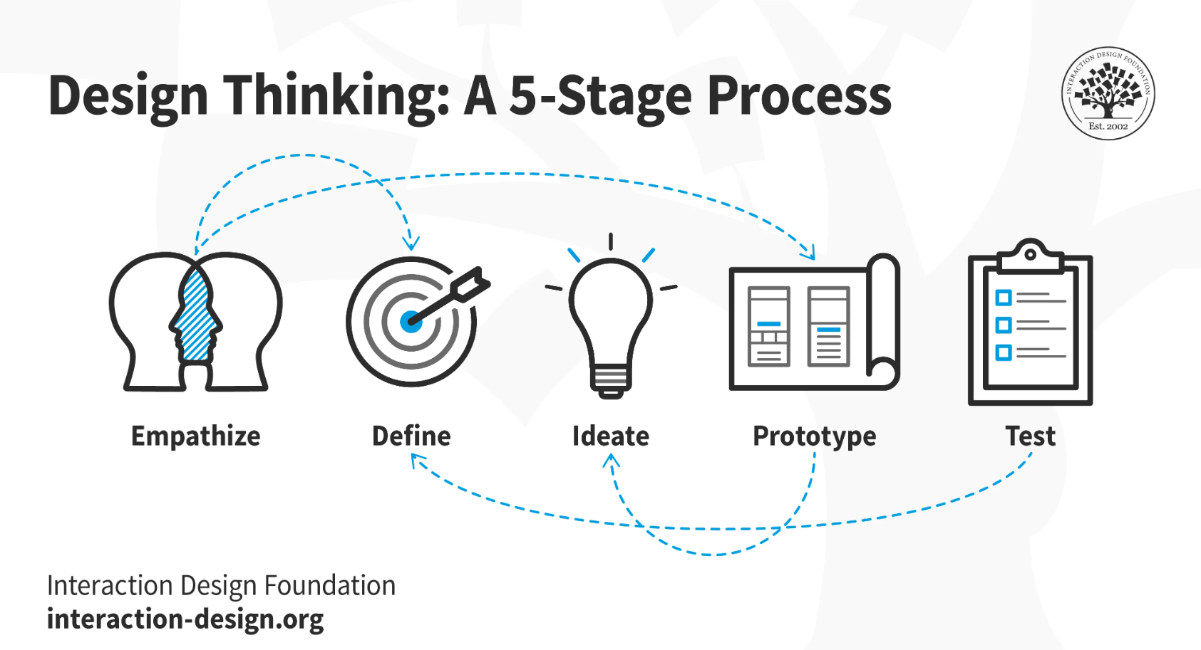

Slide 12
Empirical Understand a phenomenon
Conceptual
Form a theory
Constructive
Develop a solution

Slide 13
Questions to Consider
Why empirical research?
Core of a user-centered discipline
Users are the end goal
How does it relate to other HCI research?
Understanding users key to developing theories and solutions
Empirical skills needed to evaluate solutions

Slide 14
Questions to Consider
Why understand empirical research?

Slide 15
Questions to Consider
Why understand empirical research?
Empathising with users useful for all types of HCI research

Slide 16
Example of empirical research in HCI
Examples of empirical research papers
[O&H’16]
[Phenomenon] A field study of exploratory learning strategies
[Factor] Distance matters
[Effect] Untangling the usability of fisheye menus
[Wob’12]
[Interview study] Social use of computer-mediated communication by adults on the autism spectrum
[Diary study] A diary study of task switching and interruptions
[Lab experiment] The performance of touch screen soft buttons
[Crowdsourcing study] How deceptive are deceptive visualizations …
[Qualitative field study] Organizational obstacles to interface design and development …

Slide 17
Subtype 1: holistic understanding of a phenomenon
Examples from CHI 2021 papers:
What Do Hackathons Do? Understanding Participation in Hackathons Through Program Theory Analysis https://dl.acm.org/doi/10.1145/3411764.3445198
"Can I Not Be Suicidal on a Sunday?": Understanding Technology-Mediated Pathways to Mental Health Support https://dl.acm.org/doi/10.1145/3411764.3445410
The Landscape and Gaps in Open Source Fairness Toolkits https://dl.acm.org/doi/10.1145/3411764.3445261

Slide 18
Q1
PollEv.com/szhao168

Slide 19
Recipe for subtype 1
“Interesting” phenomena
Trendy, emergent phenomena
Open-source fairness toolkit
Voice-based interaction, Human-AI/agent interaction, metaverse, etc.
Niche, but important/cool phenomena
Hackathon
Involving people with special needs
People with suicidal thoughts (depression)
Insightful findings (usually qualitative)
Solid methodology
Note: you need to be an excellent writer with good analysis skills to do well in this category!
Note: evaluation of the paper can be more subjective (it depends on whether the reviewers think your topic and findings are interesting)

Slide 20
Subtype 2 & 3: factors and effects of a phenomenon
Examples from CHI 2021 papers:
Understanding, Detecting and Mitigating the Effects of Coactivations in Ten-Finger Mid-Air Typing in Virtual Reality https://dl.acm.org/doi/10.1145/3411764.3445671
A User-Oriented Approach to Space-Adaptive Augmentation: The Effects of Spatial Affordance on Narrative Experience in an Augmented Reality Detective Game https://dl.acm.org/doi/10.1145/3411764.3445675
Interaction Pace and User Preferences https://dl.acm.org/doi/10.1145/3411764.3445772

Slide 21
Q2
PollEv.com/szhao168

Slide 22
Recipe for subtype 2&3
“Interesting” research questions
Important factors/effects about key tasks in HCI
Coactivation in ten finger mid-air typing
Involving (complex) unknown answers and controversies
Space-Adaptive Augmentation
Has wide applicability or implications
Interaction pace
Insightful findings
Solid methodology/convincing data support (usually quantitative)
Note: you need to be logical and meticulous to succeed in this category
Note: evaluation of the paper is more objective

Slide 23
Q3
PollEv.com/szhao168

Slide 24
Relationship between subtypes
Unknown phenomenon
Unknown factors
Unknown effects

Slide 25
Relationship between subtypes
Unknown phenomenon
Unknown factors
Unknown effects
Research paper 1-
investigate phenomenon and derive factors

Slide 26
Relationship between subtypes
Unknown phenomenon
Unknown factors
Unknown effects
Research paper 1-
investigate phenomenon and derive factors
Research paper 2-
investigate known factors and find effects

Slide 27
In this workshop, we will focus on how to conduct research in subtype 2 & 3

Slide 28
Overall, what is the recipe of success for empirical research papers?
Successful empirical publication = interesting insights/results + rigorous methodology/data support

Slide 29
How to define interesting or insightful?
Is the result obvious (or surprising)?
The result is really obvious vs. the result appears obvious
Is the result simple (or complex)?
Is the result generalizable?
Does the result have important practical implications?

Slide 30
Example abstract 1
The overall pace of interaction combines the user’s pace and the system’s pace, and a pace mismatch could impair user preferences (e.g., animations or timeouts that are too fast or slow for the user). Motivated by studies of speech rate convergence, we conducted an experiment to examine whether user preferences for system pace are correlated with user pace. Subjects first completed a series of trials to determine their user pace. They then completed a series of hierarchical drag-and-drop trials in which folders automatically expanded when the cursor hovered for longer than a controlled timeout. Results showed that preferences for timeout values correlated with user pace – slow-paced users preferred long timeouts, and fast-paced users preferred short timeouts. Results indicate potential benefits in moving away from fixed or customisable settings for system pace. Instead, systems could improve preferences by automatically adapting their pace to converge towards that of the user.

Slide 31
Example abstract 2
Existing approaches to trading off false positive versus false negative errors in input recognition are based on imprecise ideas of how these errors affect user experience that are unlikely to hold for all situations. To inform dynamic approaches to setting such a tradeoff, two user studies were conducted on how relative preference for false positive versus false negative errors is influenced by differences in the temporal cost of error recovery, and high-level task factors (time pressure, multi-tasking). Participants completed a tile selection task in which false positive and false negative errors were injected at a fixed rate, and the temporal cost to recover from each of the two types of error was varied, and then indicated a preference for one error type or the other, and a frustration rating for the task. Responses indicate that the temporal costs of error recovery can drive both frustration and relative error type preference, and that participants exhibit a bias against false positive errors, equivalent to ∼1.5 seconds or more of added temporal recovery time. Several explanations for this bias were revealed, including that false positive errors impose a greater attentional demand on the user, and that recovering from false positive errors imposes a task switching cost.

Slide 32
In-class exercise
https://www.figma.com/board/8X4TQ8RfbV0gjjlK21yyc6/Day-2---In-class-exercise?node-id=0-1&t=dTNPcYNtRR1opkYZ-0

Slide 33
How to define rigorousness?
Did you use the right methods?
Is every step/features in the study design justified?
Did you perform the right analysis?
Do you have rich data (typically both qualitative and quantitative, laboratory and in the wild) to support your claims?

Slide 34
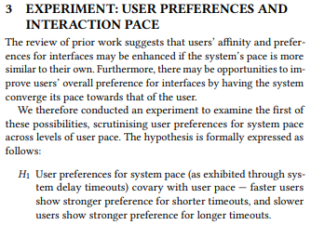
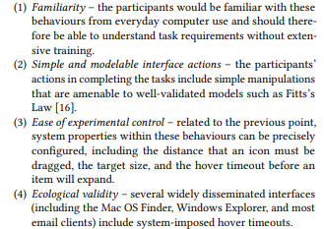
Example (Interaction Pace)
Why do we care?
Research question & hypothesis
Well elaborate reasons for task selection

Slide 35

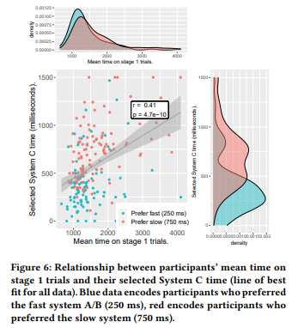

Example (Interaction Pace)
Justified parameter settings - through pilots (can also be prior literature, theoretical analysis, etc.
Triangulated quantitative and qualitative data to support claims

Slide 36
Essential elements of an empirical research paper (subtype 2 & 3)
One or more research questions
A few factors (greater or equal to 2 but less than 6)
A few measures (both qualitative & quantitative, minimum 3, commonly around 10)
For each question, there are usually more than 2 factors, and for each factor, there are typically a few measures
Interesting insights

Slide 37
Example outline for an empirical study
https://www.figma.com/board/8X4TQ8RfbV0gjjlK21yyc6/Day-2---In-class-exercise?node-id=0-1&t=dTNPcYNtRR1opkYZ-0

Slide 38
Research Questions
We conduct empirical research to answer (and raise!) questions about new or existing HCI phenomena
What are some of these questions?
Below are some examples …
Is it viable?
Is it as good as or better than current practice?
Which of several design alternatives is best?
What are its performance limits and capabilities?
What are its strengths and weaknesses?
Does it work well for novices, for experts?
How much practice is required to become proficient?

Slide 39

Are these good questions?

Slide 40
Testable Research Questions
Preceding questions, while unquestionably relevant, are not testable
Try to re-cast as testable questions (… even though the new question may appear less important)
Scenario …
You have invented a new text entry technique for mobile phones, and you think it’s pretty good. In fact, you think it is better than the commonly used soft keyboard technique. You decide to undertake a program of empirical

Slide 41
Research Questions (2)
Is the new technique any good?
Is the new technique better than soft keyboard?
Is the new technique faster than soft keyboard?
Is the new technique faster than soft keyboard within one hour of use?
If error rates are kept under 2%, is the new technique faster than soft keyboard within one hour of use?
Weak &
untestable
Broad
Stronger &
More testable
Narrow

Slide 42


Research Questions (2)
Is the new technique any good?
Is the new technique better than soft keyboard?
Is the new technique faster than soft keyboard?
Is the new technique faster than soft keyboard within one hour of use?
If error rates are kept under 2%, is the new technique faster than soft keyboard within one hour of use?
Weak &
untestable
Broad
Stronger &
More testable
Narrow

Slide 43
A Tradeoff
If error rates are kept under 2%, is the new technique faster than soft keyboard within one hour of use
High
Accuracy of
Answer
Is the new technique better than soft keyboard
Low
Narrow
Broad
Internal validity
Breadth of Question
External validity

Slide 44
Internal Validity
Definition: The extent to which the effects observed are due to the test conditions (e.g., soft keyboard vs. new)
Statistically …
Differences (in the means) are due to inherent properties of the test conditions
Variances are due to participant differences (“pre-dispositions”)
Other potential sources of variance are controlled or exist equally and randomly across the test conditions

Slide 45
External Validity
Definition: The extent to which results are generalizable to other people and other situations
Statistically …
People
The participants are representative of the broader intended population of users
Situation
Test environment and experiment tasks are representative of real world situations where the interface or technique will be used

Slide 46
Test Environment Example
Scenario …
You wish to compare two interfaces for mobile usage (e.g., text messaging)
External validity is improved if the test environment mimics expected usage
Test environment should probably involves…
Walking on a real street
Let participant to use their own mobile phones
Let them type the usual text messages they like to type
But … is internal validity compromised?

Slide 47

The Tradeoff
There is tension between internal and external validity
The more the test environment and experimental tasks are “relaxed” (to mimic real-world situations), the more the experiment is susceptible to uncontrolled sources of variation, such as environmental variations, distractions, or secondary tasks

Slide 48

How can we deal with conflict?

Slide 49
Best of Both Worlds
Internal and external validity are increased by …
Posing multiple narrow (testable) questions that cover the range of outcomes influencing the broader (untestable) questions
E.g., a technique that is faster, is more accurate, take fewer steps, is easy to learn, and is easy to remember, is generally betteq
The good news
There is usually a positive correlation between the testable and untestable questions
I.e., participants generally find a UI better if it is faster, more accurate, takes fewer steps, etc.

Slide 50
Best of Both Worlds
Internal and external validity are increased by …
Perform both well controlled study & in the wild study and show the results match each other

Slide 51
As an empirical HCI researcher, your job is to find the best set of narrow (testable) questions to answer the broader (untestable) questions!

Slide 52
Essential elements of an empirical research paper (subtype 2 & 3)
One or more research questions
A few factors (greater or equal to 2 but less than 6)
A few measures (both qualitative & quantitative, minimum 3, commonly around 10)
For each question, there are usually more than 2 factors, and for each factor, there are typically a few measures
Interesting insights
Hope the previous slides answered why we need a few factors & many measures

Slide 53
What are the subtypes of unknown factors/effects?
What factors contribute to the best design to achieve certain purposes in certain context using certain technology and why?
Simple vs. compound stroke hierarchical marking menus
What are the (interesting) effects of certain (important) factors?
False positive vs. false negative

Slide 54
How to conduct empirical research (for subtype 2 & 3)?
The “ideal” workflow of “an” empirical study
Notes:
Using XMind to show the process (so that I can show each step here)

Slide 55
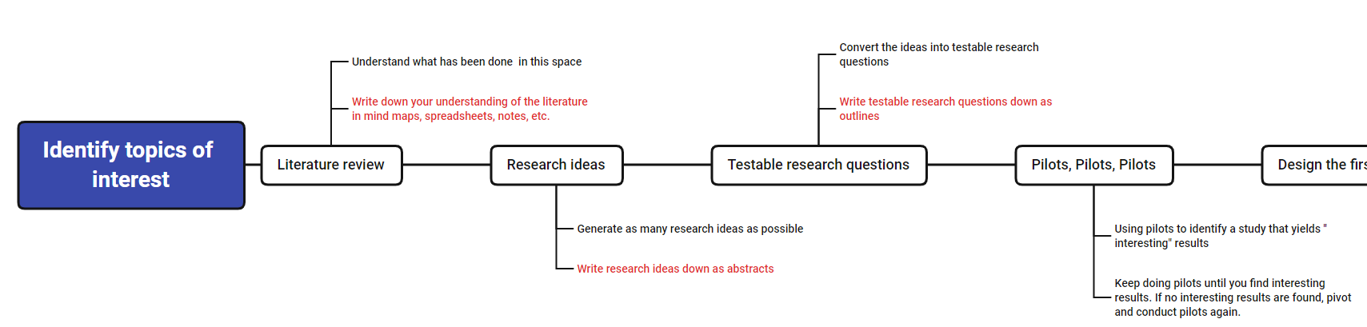
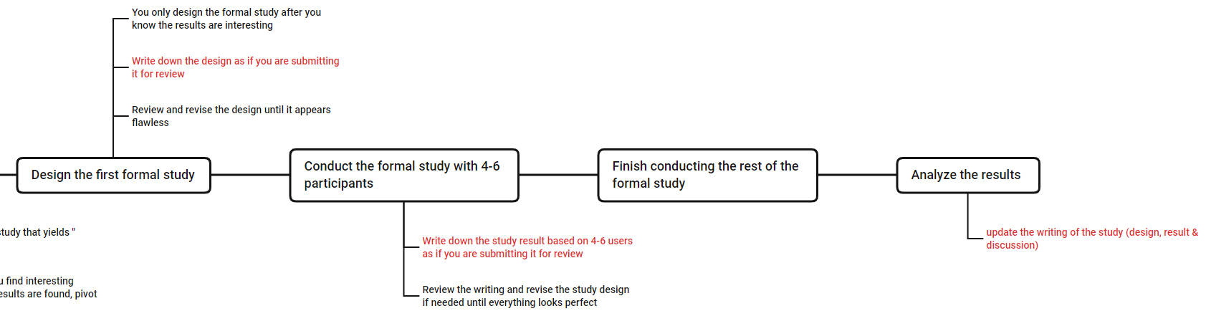
The “ideal” workflow of “an” empirical study
Stage 1: finding interesting results

Slide 56
The “ideal” workflow of “an” empirical study
Stage 2: ensure rigorous methodology

Slide 57
Characteristics of Stage 1
The main goal is to find “interesting” results/insights; however, before “interesting” results/insights are found
This process can be unpredictable
We don’t know how long it will take
We don’t know what will eventually work
Attitude in this stage:
Be adaptive and open minded
Focus on the process instead of the results (although we don’t know when can we find good results, good process can ensure good results to appear at the earliest possible time)
Don’t just work on one idea, but try to explore multiple ideas in parallel
Quick & dirty (methods may not be rigorous; using quick feedback loops to find interesting results using the shortest possible time)
Common problems:
Unable to identify interesting ideas
Waste too much time on things not necessary at this stage (e.g., trying to design every details of the pilot study)
Become inpatient or frustrating after the first few pilots do not lead to interesting results (which can often happen)

Slide 58
Characteristics of Stage 2
The main goal is to validate and explain results/insights
This process is much more predictable
We know whether we have a paper or not
We also know how long it will take to finish it
Attitude in this stage:
Meticulous
Think deep
Common problems:
Logical holes and unjustified steps/features
Shallow discussion

Slide 59

Example 1: Paracentral & Near Peripheral visualization

Slide 60
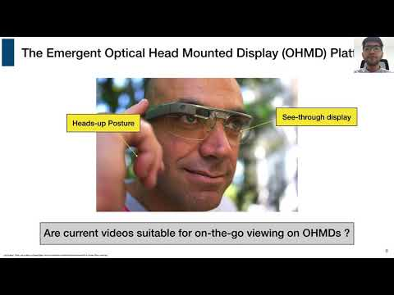
Example 2: LSVP

Slide 61
Essential questions to answer in the LSVP paper?
Do people want to watch video on the go for the purpose of learning (e.g., walking)?
If they do, what factors contribute to the best design (using smart-glasses)?
How does the best design compare with existing solutions?

